Slide 1
Comprehensive Evaluation Process for English Learners (CEP-EL)
Supporting ELs with Disabilities Symposium
May 3, 2016
Angela Gaviria, Ed.S.
Timothy Tipton, M.A., CCC-SLP
Culturally & Linguistically Diverse Transdisciplinary Team

Slide 2
Authors of CEP-EL
Angela Gaviria
Education Specialist/Project Resource Teacher
Tiffany Jones-Cristiani
School Psychologist
Tim Tipton
Senior Speech-Language Pathologist
In consultation with Jaime Hernandez, Ed.D.
In collaboration with Sonia Picos, Special Ed, SDUSD
Reviewed by Community, Special Educators, SDUSD English Learner Department and Administrators

Slide 3
Foundation of CEP-EL
Based on:
Laws and Regulations
Federal (IDEIA ‘04)
State (CDE Composite of Laws)
Consultant recommendations
Research on best practices for ELs
Current practice

Slide 4
Strategies for Success
Collaboration
PD
Data
Collaboration
Data Collection
Professional Development

Slide 5
Comprehensive Evaluation Process for English Learners (CEP-EL)
www.sandiego unified.org/ parent-services-office

Slide 6
Comprehensive Evaluation Process for English Learners (CEP-EL)
Provides procedures for district staff to ensure appropriate:
Referrals
Evaluations
Identification for services
Neither Over- or Under-
IEP Supports

Slide 7
When to Use the CEP-EL
When students are experiencing academic and/or behavioral difficulties in any area as determined by:
Performance data across settings
Patterns of strengths and weaknesses
Comparison to peers (where possible,
from similar backgrounds)
Notes:
7

Slide 8
CEP-EL Focuses on Difference vs. Disability
Typically developing ELs manifest similar academic and language difficulties as students with special needs
However, the causes behind these difficulties differ
Extrinsic vs. Intrinsic
Notes:
8

Slide 9
CEP-EL Sequence
Early Intervention
Cumulative File Check
Intervention Summary
After Referral
Comprehensive Evaluation Process for English Learners Checklist
Extrinsic Factors

Slide 10
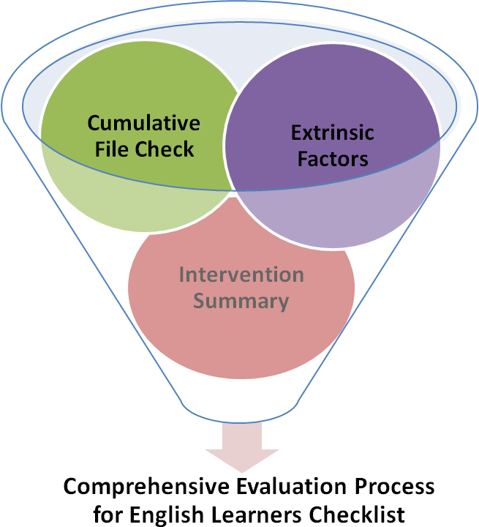
CEP-EL Tools

Slide 11
EL Initial Referral & Decision Making Flowchart
Guides site teams in step-by-step decision making
Focuses on Problem-Solving Teams ruling out extrinsic factors as primary contributors to concerns
Encourages Response to Instruction & Intervention in extrinsic factors, academic and/or behavioral concerns impacting achievement
HANDOUT
CEP-EL Manual Page 65

Slide 12
Student Cumulative File Check
Supports the review of background information
Promotes early data-gathering and collaboration between site staff.
CEP-EL Manual Page 66
Notes:
12

Slide 13
EL Extrinsic Factors Form
Promotes further investigation into extrinsic factors, parent input and identification of student strengths.
Links to best practices in English learner education.
Use form as guide,
NOT questionnaire
CEP-EL Manual Page 67
Notes:
13

Slide 14
Focus at ALL Levels

Slide 15
EL Intervention Summary
Provides documentation of interventions tried and their outcomes.
Interventions are documented in the following areas:
Extrinsic factors
Academic concerns compared to peers
Behavioral concerns that impact achievement of grade-level standards
CEP-EL Manual Page 70
Notes:
15

Slide 16
CEP-EL Checklist
Review of Background Information
Parent participation
Provision for students with severe concerns
Provision for students already identified
Supported by other forms
Assessment
Comprehensive assessment
Mandatory health assessment
Assessment in primary language
Appropriate tools and qualified assessors
Handout & CEP-EL Manual Page 71
Notes:
16

Slide 17
Data Gathering Tools
Type of Data | Description | Examples
Records Review | Gathering student background information through a review of existing data | Cum Review Previous school records Problem-solving meeting notes (RtI, SST…) Documentation from Related Agencies District data collection systems Community and School Demographics Home language survey Report cards Learning contracts Instructional programs attended Attendance history
Interviews | Gathering information from those that know the student best | Student, caregiver/family, teacher… May involve interpreter, cultural and/or linguistic liaison Student interest inventories (e.g., journals) Questionnaires
Observations | Gathering information through a systematic & direct focus on actual and relevant behaviors in authentic contexts | Anecdotal, narrative and observation notes Social & Academic language observations Observations across content areas Observations in areas of student strength

Slide 18
Data Gathering Tools
Type of Data | Description | Examples
Sampling | Gathering samples of behavioral data for further analysis | Classroom work samples (portfolio review, projects, learning logs, journals, writing samples) Running records Oral language samples across contexts (conversation, narrative, expository, persuasive, oral reports, informal story telling)
Probes & Standardized Testing | Probing for information in a specific area during a highly-structured task and comparing performance to groups of students | English Language Proficiency Tests Primary Language Proficiency Tests Academic Assessments Primary language academic assessments (e.g., standards-based test in Spanish) Probes for cognitive processing
Criterion-Referenced Measures | Comparing student performance to established criteria of well-defined, specific behaviors | Rubrics Rating Scales Checklists (academic language and social language, classroom instruction) Curriculum assessments (classroom-based measurements, benchmarks)

Slide 19
CEP-EL Checklist
IEP Team Determination of Eligibility
Not based on one source of information
Exclusionary criteria
Rationale for primary handicapping condition
IEP Team Supports and Services
Knowledgeable team member included
Interpreter use
Least restrictive environment
Goals aligned to English language development needs
Notes:
19

Slide 20
Angela Gaviria agaviria@sandi.net Tim Tipton ttipton@sandi.net
Notes:
20

Slide 21
References/Resources
Dunaway, C., Kenny, E., Chandler, M.K. (2006). Forming Transdisciplinary Teams: Performance-Based Assessment. San Diego Unified School District. Retrieved on 3-1-2010
Fergus, E., Ahram, Roey. Racial/Ethnic Disproportionality in Special Education. Data Analysis Workbook. NYU Steinhardt. http://steinhardt.nyu.edu/metrocenter.olde/index/dataanalysisworkbook.pdf
Gaviria, A. & Tipton, T. (2012). CEP-EL: A Comprehensive Evaluation Process for English Learners. A Process Manual. San Diego Unified School District. www.sandiego unified.org/ parent-services-office
Hamayan, E., Marler, B., Sanchez-Lopez, C., & Damico, J. (2007). Special Education Considerations for English Language Learners: Delivering a Continuum of Services. Philadelphia: Caslon Publishing.
Notes:
21

Slide 22
References/Resources
Hehir, T. and Mosqueda, E. (2007). San Diego Unified School District Special Education Issues Document, Final Report. Submitted to San Diego Unified School District.
Hernandez. J., (2009). Study to Examine the Disproportionate Identification of Minority and Linguistically Diverse Students in Special Education in the San Diego Unified School District. Submitted to San Diego Unified School District, August 29, 2009.
Los Angeles Unified School District, Division of Special Education. Comprehensive Evaluation of Students Suspected of Emotional Disturbance (ED), September 29, 2004
Rhodes, R., Ochoa, S., Ortiz, S. (2005). Assessing Culturally and Linguistically Diverse Students: A Practical Guide. New York: The Guilford Press.
Sullivan, A. (2011). Disproportionality in Special Education Identification and Placement of English Language Learners. Council for Exceptional Children. Vol 77, No 3, pp. 317-334.
Notes:
22

